Slide 1

The law society of nunavut
2023-24 AGM
Overview OF REPORTS
Discipline Committee
Membership & Admissions Committee
Rules Committee (Update)
&
Nunavut Law Foundation

Slide 2
Chairperson
National Discipline Standards
Statistics
At January 1, 2023, four files from 2022 remained open:
▪ Two were disposed of in 2023; and
▪ Two remain open.
In 2023, six new complaints were filed in 2023:
Two complaints have been disposed of without further action;
One complaint was closed as the complaint was withdrawn; and
All three remaining complaints are still ongoing.
New complaints filed in 2024 will be reported at next year’s AGM.
4. Overhaul of the Legal Profession Act
Discipline Committee

Slide 3
THE statistics are compiled annually on March 31 to include the outcomes of the annual membership renewals (resignations, suspensions, change of status, etc.).
- On March 31, 2024, MAC had considered 45 regular applications for membership including 22 combined regular/Restricted Appearance Certificate (RAC) applications.
- The regular membership application numbers decreased by 15% in comparison to last year’s numbers.
- In 2023, MAC did not receive any NEW student-at-law application although the LSN continued to receive regular inquiries from individuals who have completed either their entire or portions of articles elsewhere.
A. STATISTICS
Membership & Admissions
Committee

Slide 4
As of March 31, 2024, there were 70 active resident members, including a number of lawyers from the Nunavut Law Program.
The average resident bar in the last ten years has been 76 members.
In comparison to the non-resident bar:
- 2014 192 active non-resident members.
- 2024 263 active non- Resident lawyers.
AN increase of roughly 37% from 2014.
Membership & Admissions
Committee

Slide 5
- March 31, 2024: 95 lawyers were practicing under a RAC (both new and renewed).
- March 31, 2023: 79 RACs had been issued.
- increase of 20.3%.
It is important to note that of the 95 RACs, 28 applicants ultimately got called to the Nunavut bar after submitting a combined RAC/ regular membership application.
Membership & Admissions
Committee

Slide 6
(I) Streamlining the Application Process
(ii) Formalizing and Clarifying Aspects of the Application Process
- Assurance and Authorization Form
- Letter of good character
- Listing of NCA Certification in the Law Degree Section of the Application Form
B. Other Activities and Projects
Membership & Admissions
Committee

Slide 7
- Conflicts of Interest, Quorum and Voting for the Executive Committee: ongoing with the executive committee
- Interest-bearing trust account and mandatory reporting to the LSN or to a member’s home jurisdiction
- LPA overhaul and amendments to the rules
- The Roll and the Record s. 34-37 of the Rules of the LSN; s. 14 of the LPA : What is the Regulated baseline information for the online LSN membership directory.
General Update
Rules
Committee

Slide 8

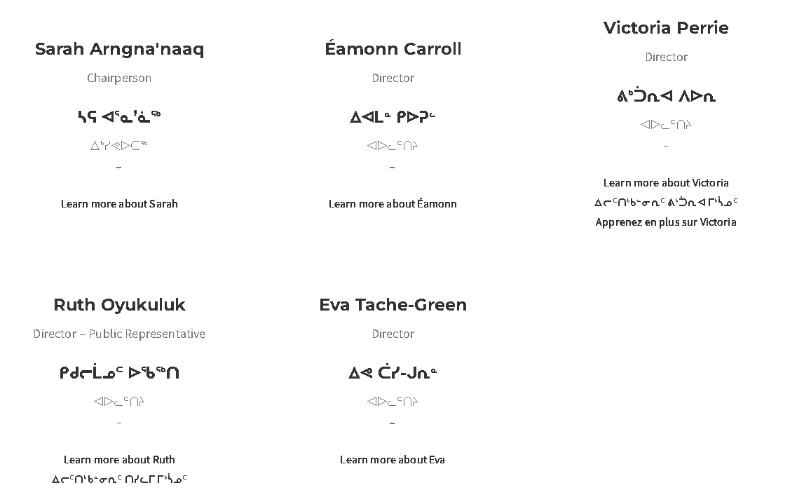
Directors

Slide 9
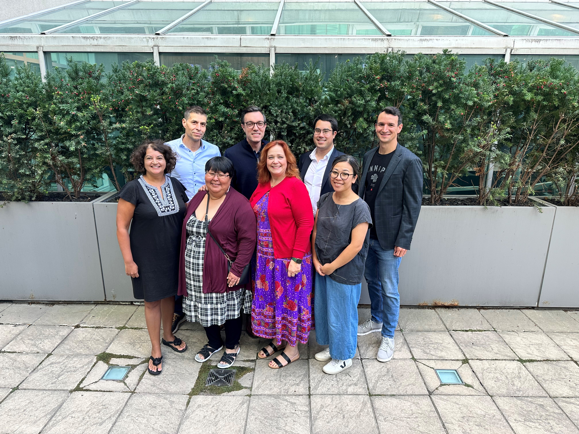
Cy-PrÈs Award
Cy-Près Award
In the fall of 2023, the Nunavut Law Foundation was approached by the Law Foundation of British Columbia and offered a generous portion of a cy-près award they had been granted.
A big thank you to the Law Foundation of British Columbia for this very generous contribution.

Slide 10
IOL
IOLTA
Aside from awarding the regular awards and grants, the focus of my tenure as Chairperson has been securing an increase in our long-term, sustainable funding through the enforcement of section 57(2) of the Legal Professions Act. That is to say, the collection of interest on lawyers’ trust accounts (IOLTA).
The Board is hopeful that with additional funds, we will be able to increase the Foundation’s capacity to fulfill our mandate. During the 2023 year, we took concrete steps towards being able to collect this additional funding, though barriers continue to present themselves in this process.
We are hopeful that we will have the IOLTA collection process finalized with each major bank in the 2024 year.

Slide 11
UPINNAQTUQ AWARD FOR YOUTH &
YOUNG STUDENTS
Alice Kilaodluk from Cambridge Bay
Cynthia Kilabuk from Iqaluit
Desiree Kalluk from Resolute Bay
Eunice Kalluk from Resolute Bay
Joanasie Aglak from Pond Inlet
Josiah Kalluk from Resolute Bay
Kallaarjuk Taukie from Kinngait
Kaniq Allerton from Iqaluit
Katsuaq Saila from Kinngait
Kiana Ekpakohak from Cambridge Bay
Kiana Laurer Kitigon from Cambridge Bay
Kim Canlas from Iqaluit
Kupaaq Kalluk from Resolute Bay
Nathalie Lexus Dion from Rankin Inlet
Samuel Kalluk from Resolute Bay
Sandy Temela from Kimmirut
Suki Hogaluk from Cambridge Bay
Tanner Kalluk from Resolute Bay
Tia Kilabuk from Iqaluit

Slide 12
General grant
The Foundation has funding available under its general grant, where projects that fall within the Foundation’s mandate can apply for financial support.
This year, a $10,000 grant was awarded to assist with the costs of running a successful Intensive Trial Advocacy Program held in Iqaluit in September.

Slide 13
Lucien ukaliannuk award for law or law-related
Stephanie Tagalik Eccles, Bar Admission Program

Slide 14
SUMMARY OF 2023 DISBURSEMENTS
General Grant $10,000
Lucien Ukaliannuk Awards $9,522
Upinnaqtuq Awards $2,000
Administrative Costs $9,163
Professional Fees $11,163
TOTAL $41,848

Slide 15
Questions?

